Slide 1
FINAL PROJECT BUSINESS CASE 4
INVESTMENT REPLICA
Group 8

Slide 2





OUR TEAM
Andrea Violante
Marsona Panci
Francesco Stillo
Gaia Imperatore
Nicola Baldoni
MST – Statistical Learning
MST – Statistical Learning
MMF – Quantitative Finance
MMF – Quantitative Finance
MMF – Quantitative Finance

Slide 3



Agenda
01
02
03
04
Data Exploration
Regression
Kalman Filter
Monster Index Forcasting

Slide 4
Our Objective
The portfolio will be heavily weighted towards equities
(≈ 80%)
Construction of a portfolio that mirrors the performance of a specific market index, tailored for a young, financially savvy client aged 20-25.
This strategy acknowledges potential market downturns but leverages the long-term growth potential of a predominantly equity-based portfolio.
To diversify risk and enhance stability, a minor allocation will be dedicated to bonds (≈ 15%) and other alternative assets (≈ 5%).

Slide 5
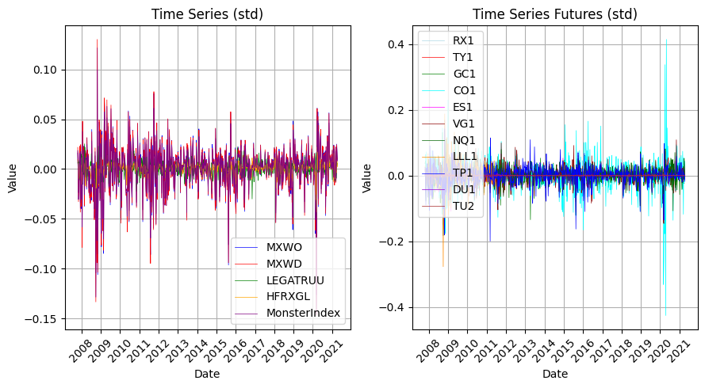
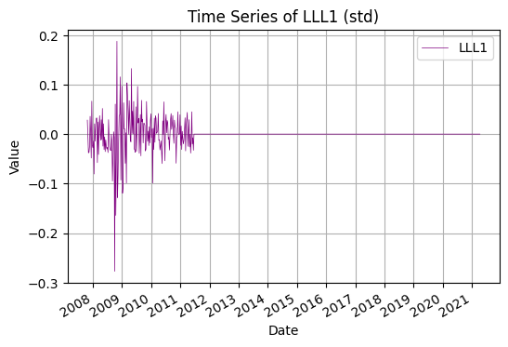
1. DATA EXPLORATION
The price of the LLL1 futures contract has been stagnant since 21 June 2011. While we presume that trading for this contract has been halted, we have been unable to verify this information through our investigations. Due to the possibility of data corruption, we have made the decision to cease using this financial instrument.

Slide 6
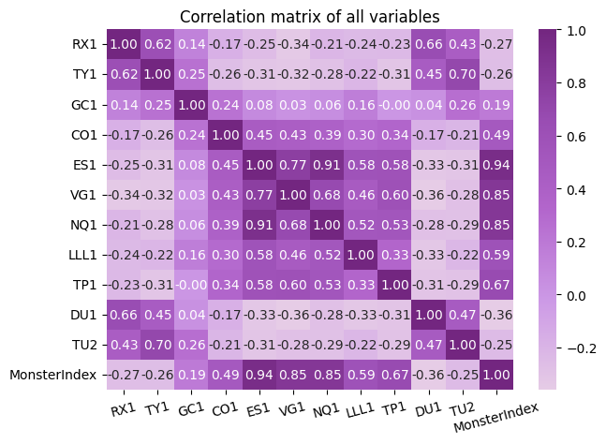
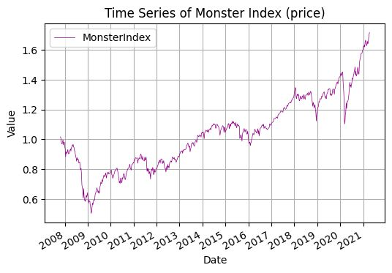
1. DATA EXPLORATION
ES1 is a future on S&P 500 and NQ1 on Nasdaq100 i.e. the index of the first 500 US companies and the first 100 US tech companies so it’s obvious that they have high correlations (most likely the Nasdaq100 companies are also in S&P500)

Slide 7
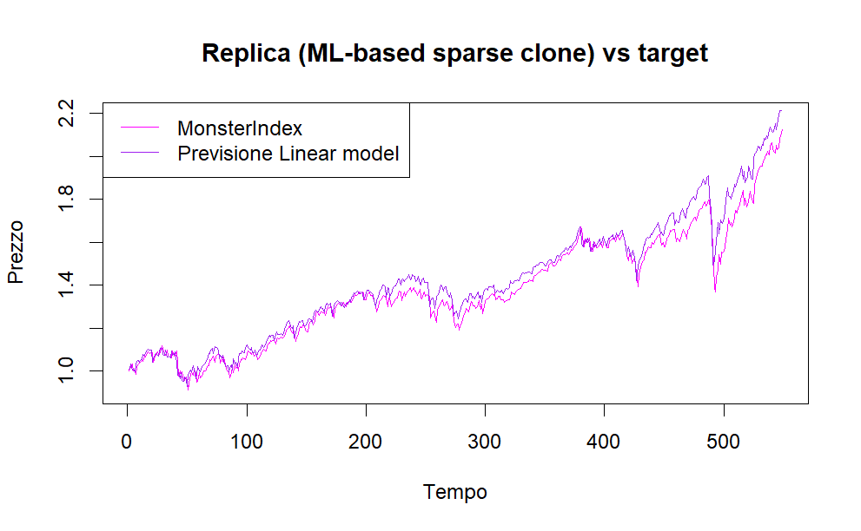
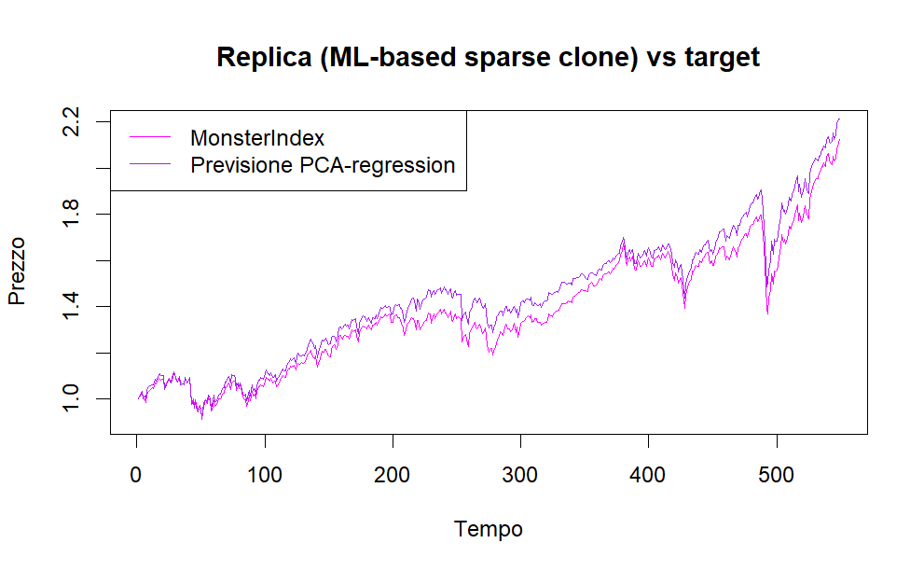
2. REGRESSION
LINEAR REGRESSION
Ease of Implementation: Linear models are easy to implement and require fewer computational resources compared to more complex models.
Predictive Power: Despite their simplicity, linear models can provide strong predictive performance for many types of data.
Collinearity issues: Due to the correlation among some of our indices, linear regression might not be the most suitable model for our analysis.
PCA REGRESSION
Handling collinearity: Principal Component Analysis (PCA) helps by transforming the data, reducing the impact of collinearity.
Improved Model Interpretability: By projecting the covariates along the principal components, we create a new linear model. Although initially complex, we retransform the data to make the model more interpretable, maintaining the essence of the original variables.
Enhanced Variability Capture: The coefficients in the transformed model are designed to maximize variability, ensuring that our model captures the most significant patterns in the data. This process also identifies and potentially removes less influential variables, streamlining the model.

Slide 8
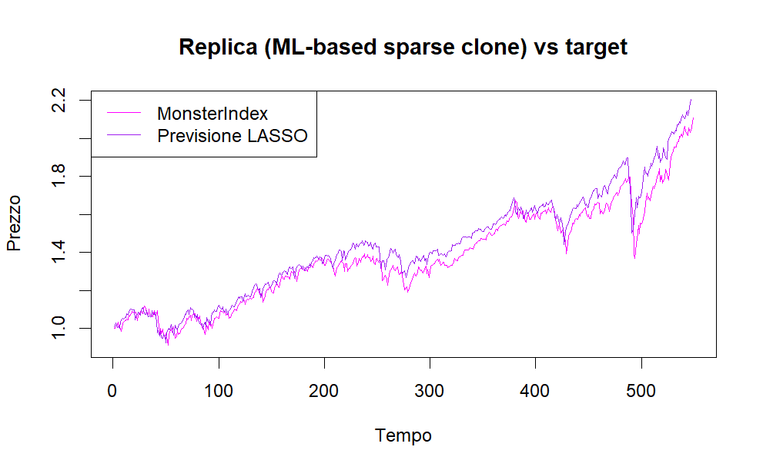
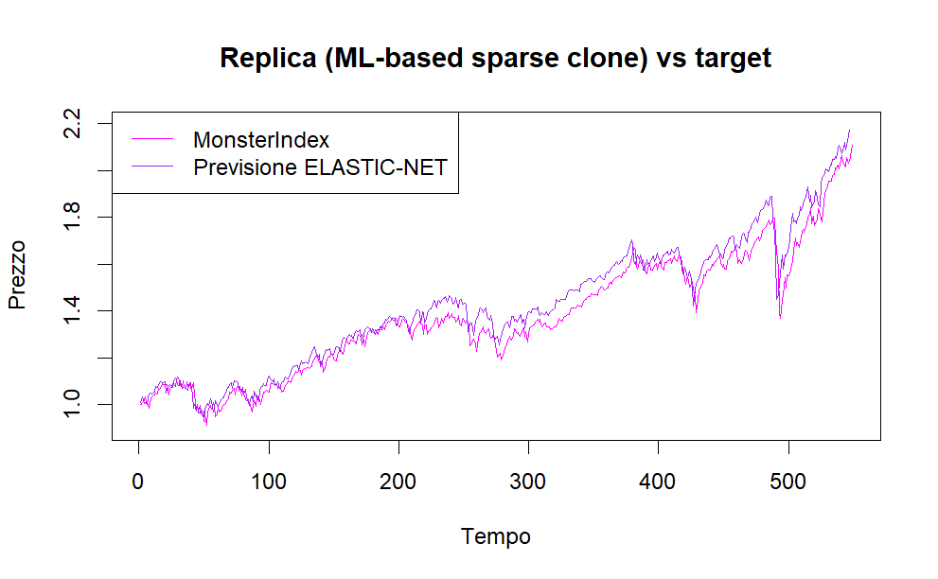
2. REGRESSION
LASSO REGRESSION
Sparse Solutions: Lasso encourages sparse models by shrinking coefficients, effectively performing feature selection and simplifying the model.
Multicollinearity Handling: It effectively handles multicollinearity by setting coefficients of correlated predictors to zero.
Automatic Feature Selection: Lasso inherently selects the most relevant features, enhancing model interpretability.
ELASTIC NET
Combination Regularization: Elastic Net combines Lasso and Ridge regression, balancing between feature selection and coefficient shrinkage.
Balanced Approach: It strikes a balance between L1 and L2 penalties, effectively handling multicollinearity while performing variable selection.
Tunable Hyperparameter: Elastic Net offers a tunable alpha parameter, providing flexibility in controlling the level of regularization based on dataset characteristics.

Slide 9
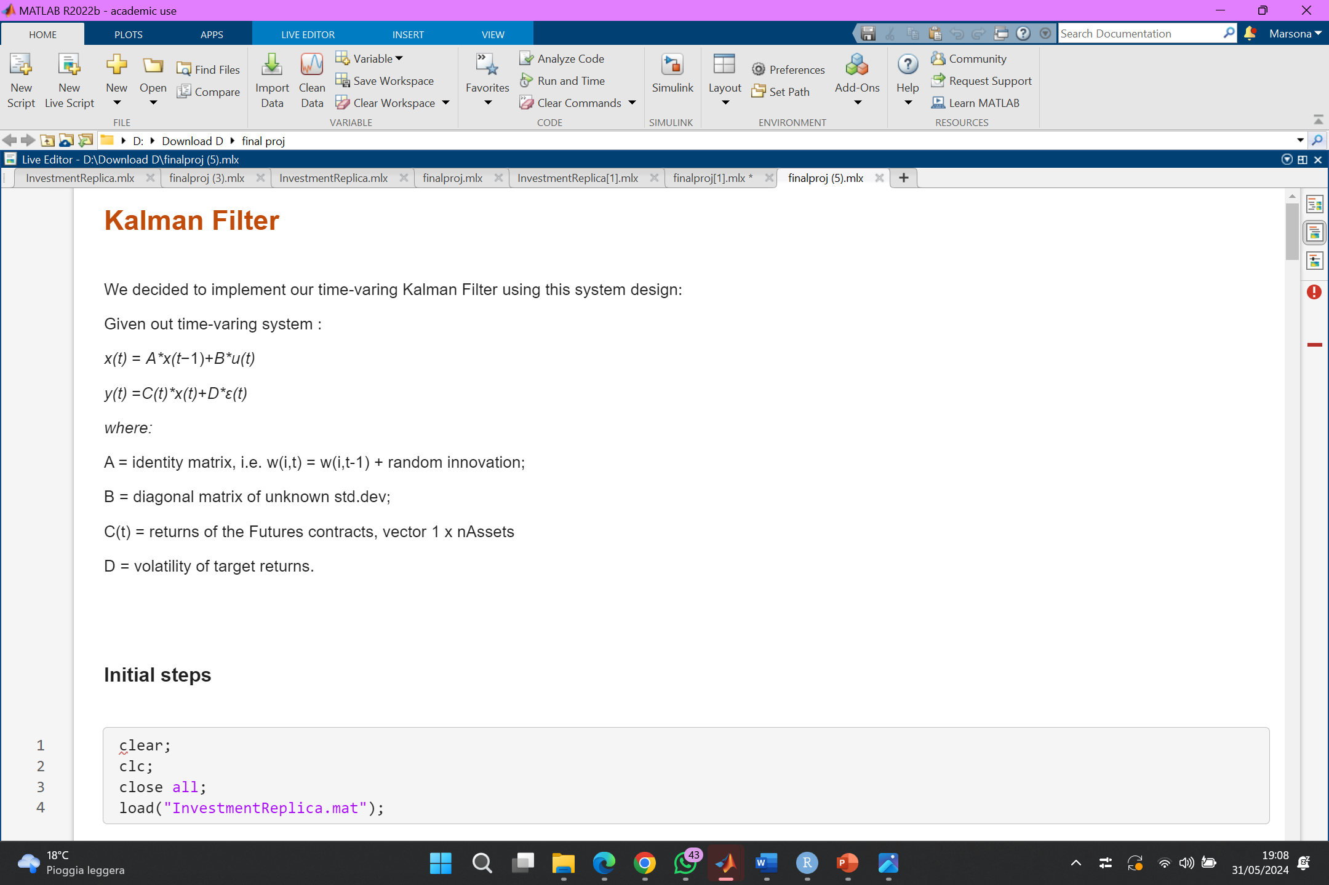
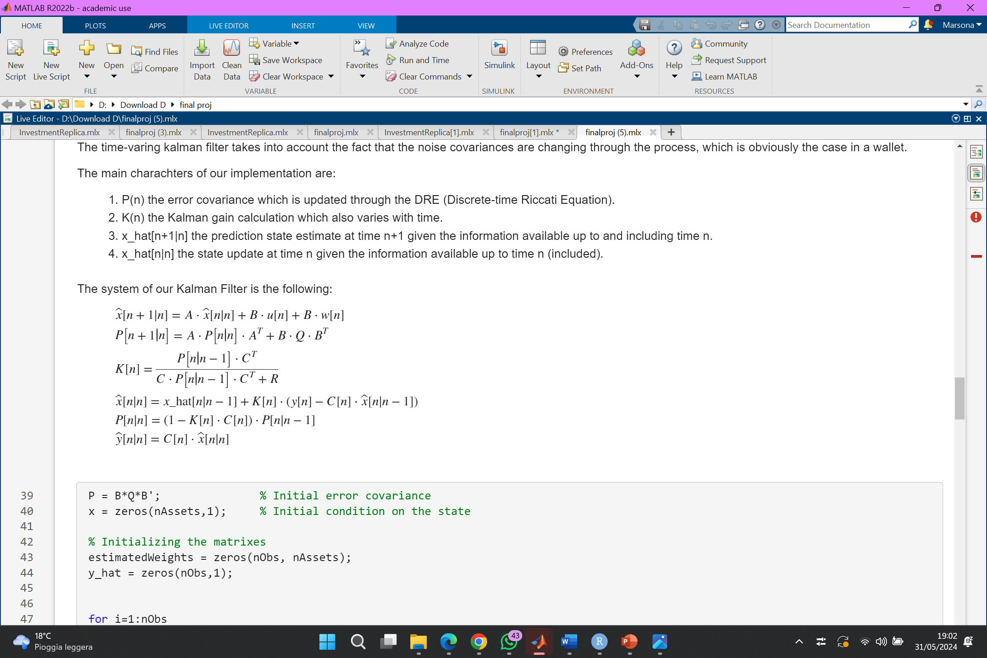
3. KALMAN FILTER
INITIAL SYSTEM
Weight Estimation: In the field of investments, KF is applied to determine the weights (states) of a portfolio model.
Assumption of Linearity: It presumes linearity in the process of state transitions, accurately relating these transitions to the target returns (output).
Adaptability: KF is highly effective in dynamic settings, adeptly capturing changing market conditions.
Noise Management: It is particularly proficient at handling noisy data, making it a reliable choice for financial analysis
1. UPDATE RULES
2. PREDICTION RULES

Slide 10
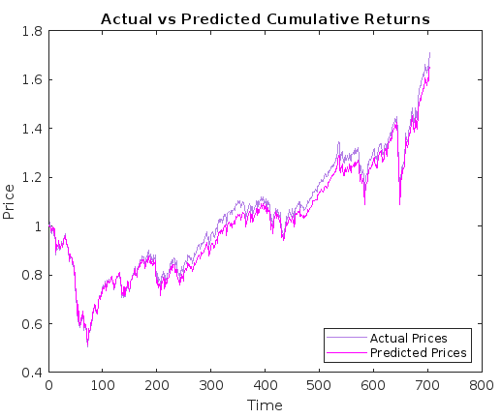
3. KALMAN FILTER
Interpretation and Importance of Parameters
A, B, and D initialization tailored to the Monster index characteristics.
R reflects measurement uncertainty due to volatility.
Q controls process noise, ensuring independence and aiding convergence.
Parameter choices crucial for accurate filtering and prediction.
Key Kalman Filter Parameters Calculation:
R: Measurement Noise Covariance derived directly from the volatility of target returns, indicating measurement uncertainty.
Q: Process Noise Covariance constructed as a diagonal matrix to ensure independence of noises, controlling process noise to aid convergence.

Slide 11
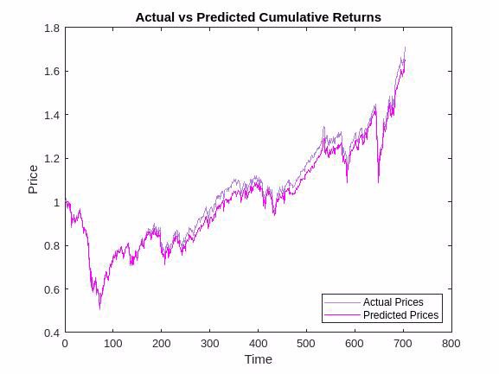
3. KALMAN FILTER
Press play:
Equity Futures Influence:
Expect positive weights for equity futures, especially US (ES1, NQ1) and EU (VG1) markets heavily represented in MSCI WORLD index.
Reflects significant exposure in stock market.
Bond Market Influence:
Expect minimal significance or small/negative/volatile weights for interest rate indices (e.g., TY1, RX1, DU1).
Indicates minimal exposure in bond market.
Energy and Gold Futures:
Energy futures (CO1) expected to have insignificant influence.
Gold futures (GC1) may have positive influence, correlated with US market performance.

Slide 12
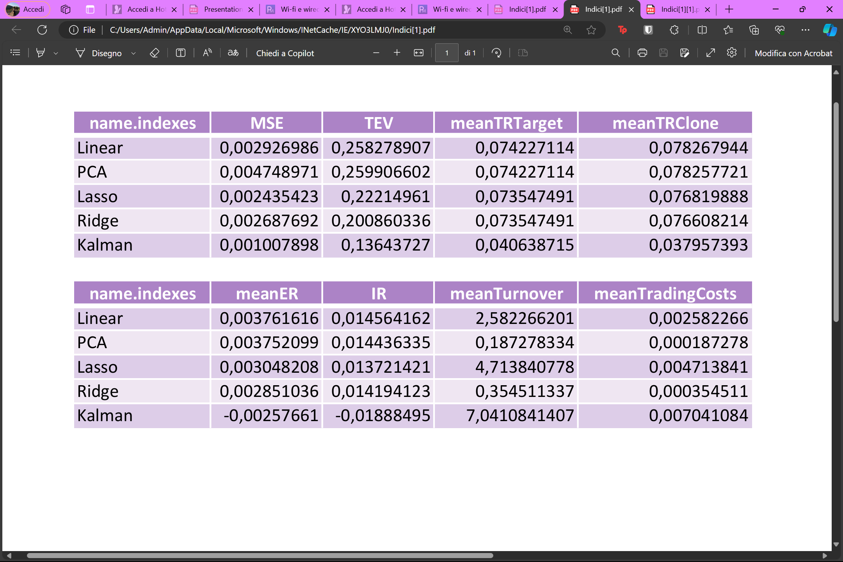
MODEL COMPARISON
Elastic Net
Elastic Net

Slide 13
MODEL COMPARISON
To assess the effectiveness of different models, we employed two key metrics: mean squared error (MSE) and standard deviation of the tracking error. The tracking error refers to the difference between the target returns and the returns generated by the model.
Our analysis revealed that the Kalman filter achieved the lowest MSE and standard deviation of the tracking error. This implies that the Kalman filter produced the most accurate and stable results.
Elastic Net
However, it's important to note that the Kalman filter also exhibited the highest mean turnover, signifying a greater frequency of portfolio rebalancing throughout the year.
This increased trading activity could translate to higher transaction costs.Therefore, we recommend using the Kalman filter as a benchmark for evaluating the performance of other models.
However, for clients with a high risk aversion, the Kalman filter might be a suitable choice due to its superior accuracy and stability.
Elastic Net

Slide 14

4. MONSTER INDEX FORECASTING
What is “Prophet”?
Prophet is a forecasting model developed by Facebook (now Meta) designed to predict time series data exhibiting seasonality, trends, and structural changes. By decomposing data, it provides accurate predictions.
Is it reasonable?
Assuming the Monster Index, primarily composed of stocks, tends to reward investors over the long term, short-term fluctuations that our model might not capture can still make the forecast broadly promising.

Slide 15
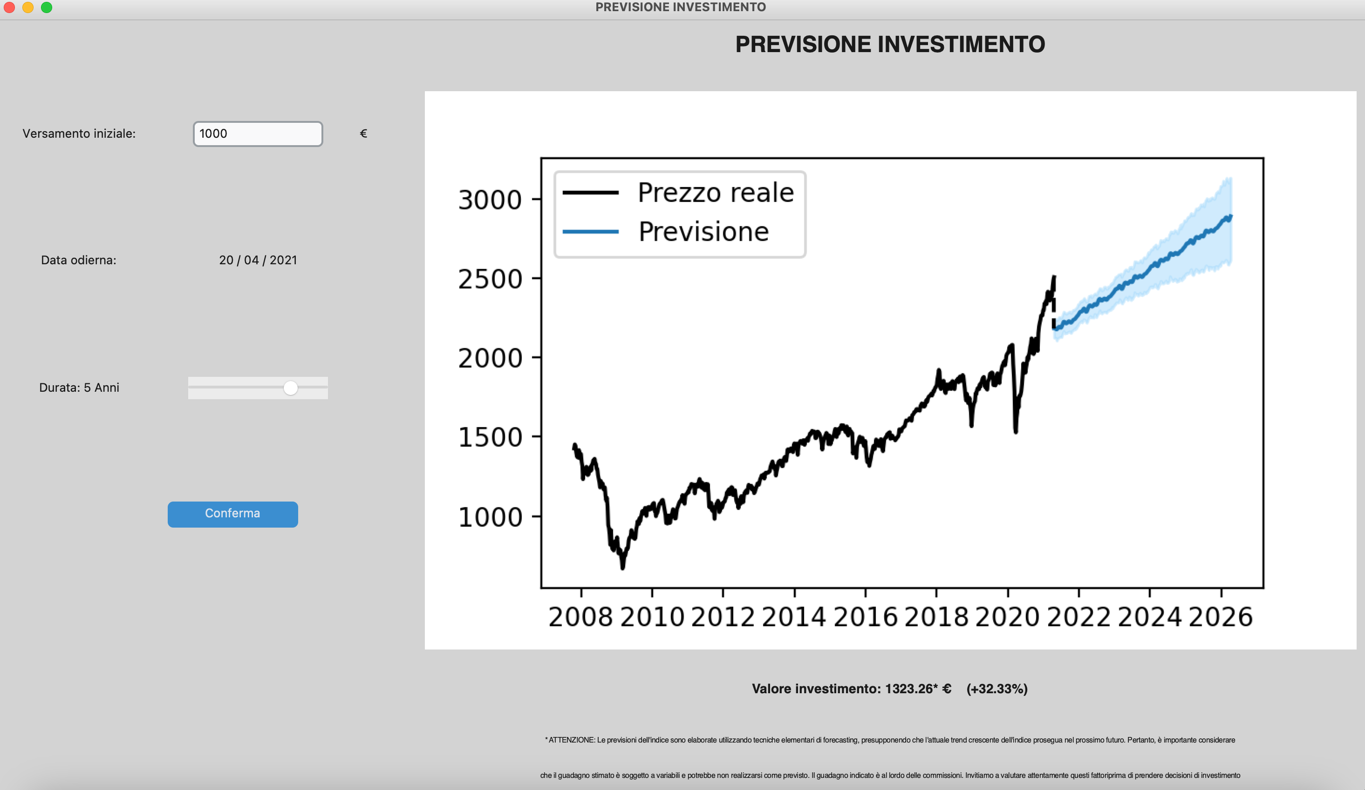
4. MONSTER INDEX FORECASTING
User-friendly interface:
To provide a more direct and user-friendly experience, we've created an intuitive interface that allows clients to explore and experiment with potential long-term returns on investments in the Monster Index (excluding replication fees). This interactive tool makes it easy to visualize and understand how such investments could grow over time.
** Our prediction was made assuming an increasing trend (no market’s crisis)!

Slide 16

Average university student who trust our models:
THANK YOU !

